Slide 1

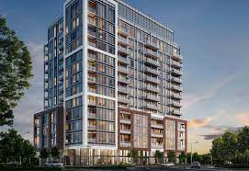
Ether-airbnb Real Estate Dapp
By: ameer Irfan, tejas patel, tarangkumar patel, Maurice Le Gendre, and james Anderson

Slide 2
introduction
Thanks to the strengths of blockchain technology, which makes NFTs reliable, secure, fast, and effective, you can:
Prove ownership of a digital or physical object with a specific NFT utilizing the ERC721 standard
Easily trade or exchange assets represented by NFTs by simply transferring NFTs within a blockchain network
Keep immutable and transparent asset sales records on the blockchain

Slide 3
How can you use NFTs in real estate?
In real estate, NFTs represent properties. A real estate owner receives payment in tokens via a crypto marketplace, and the buyer receives an NFT in their digital wallet. This NFT represents ownership of a particular real estate object.
The blockchain isn’t new technology for real estate, since smart contracts are already used to digitally arrange sales and payments. A smart contract can also be used to store information about an NFT and act as a self-executing program ensuring that all sales agreement conditions are met.
Once tokenized, the programmable Ethereum blockchain enables the secure and compliant digitization of the transactions and processes around these assets, including issuance, trading, and lifecycle management.

Slide 4
NFT’s in Real EsTATE
In the real estate market, the advice, knowledge, and know-how of real estate professionals will remain crucial to commercial buyers. However, the processing of securities, liability management, document processing, and accounting will inevitably change with the capability of peer to peer transactions without the need for any intermediary if all parties so wish it.
Because of the inherent immutability of blockchain transactions NFT’s will also reduce fraudulent transactions in the real estate market.
Interesting FACT:
In an online presentation on fraud and identity theft from 2012, mortgage insurer Canada Guaranty notes that “one in 10 mortgage applications will have some element of fraud." Credit bureau Equifax says it had been able to flag nearly $1-billion worth of attempted mortgage fraud among its lender clients since 2013.

Slide 5
Objectives
To create a decentralized application in which properties can be rented out,
Payments will be peer to peer and conducted on the Ethereum blockchain.
Initial scope – to create a dApp where ALL real estate transactions could be transacted. Rent, Buy, and Sell - Including Fractional Investing distributed amongst groups of investors.

Slide 6
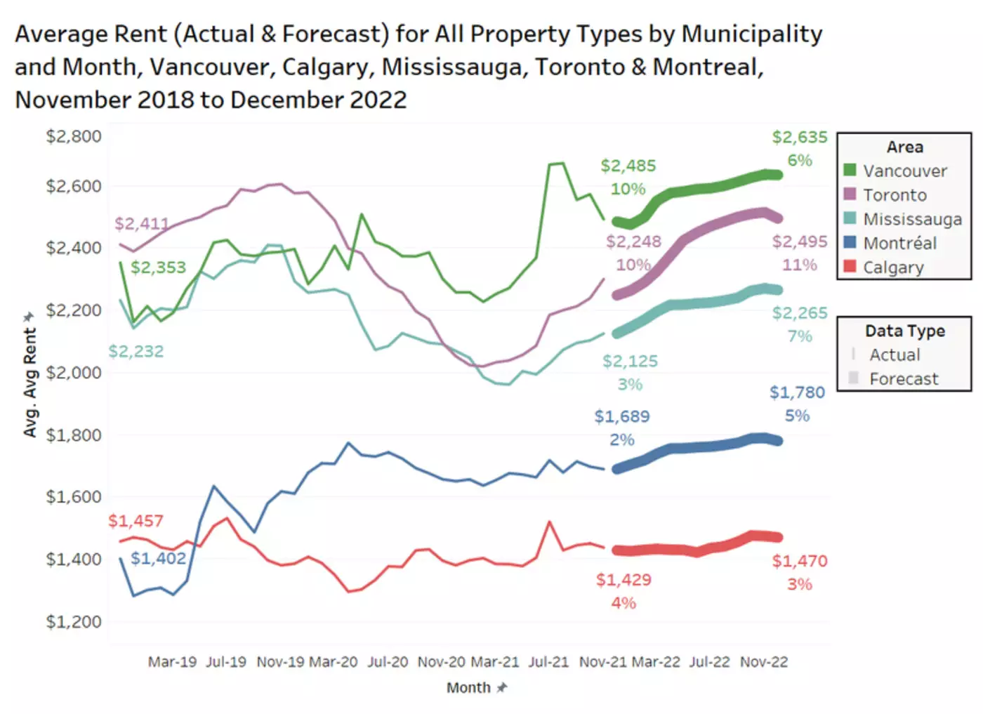
Average Rental Price for Real Estate in Canadian Cities and projections

Slide 7
Tools
Languages: Python, Solidity, javaScript, HTML
Streamlit, Ganache, Metamask,
NodeJS, React, Truffle
DEMONSTRATION

Slide 8
Conclusions
Blockchain and Smart Contracts offers a chance for real estate transactions to be conducted on a trusted, peer-to-peer network.
By utilizing dApp’s connecting users Wallets transactions could be completed.

Slide 9
challenges
Bugs connecting front end to back end (initial attempt to use js, then switch to Streamlit)
Time constraints
Advanced concepts in Solidity programming
Given more time and resources we would have developed this dApp utilizing a proper Escrow contract with built in legalities in solidity. And both ERC721, and ERC1358 standards for fractional investing.

